Slide 1
Unity FPS Character Controller Project
By Jeremy Zoitas

Slide 2

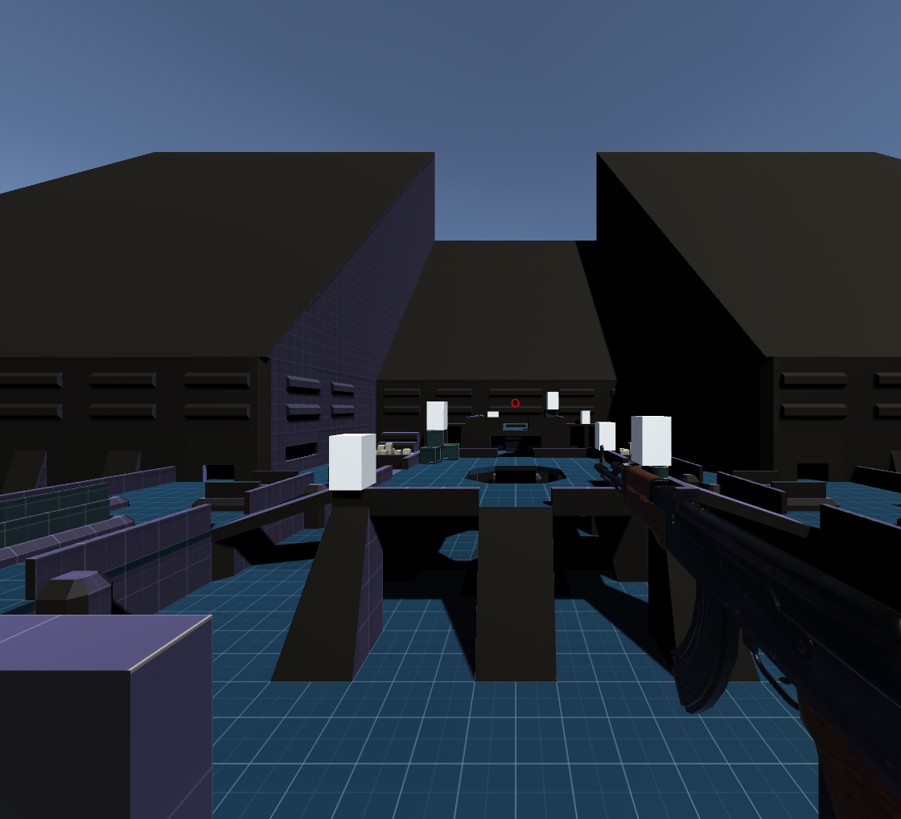
Overview of the project.
Allow users to create their own kind of first-person character controller to fit their style of game using this Unity asset.
The project focused on the player movement to allow for velocity making the player gain speed and slow down.
The pre-production of the project went from February to June and the development was carried out from July to November giving it five months to be developed.

Slide 3
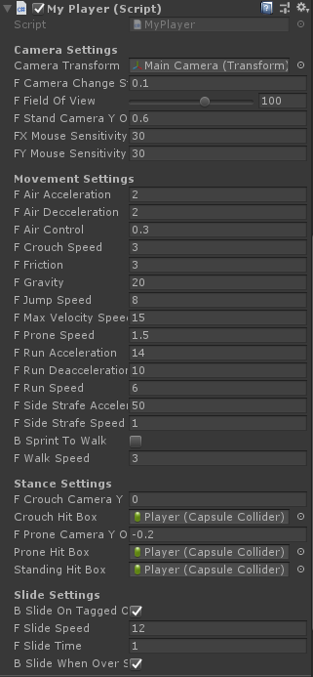
Features included.
- Walking. - Sprinting. - Jump. - Crouch, Slide and Prone. - Weapon model. - Change field of view and sensitivity. - Sliding down slopes/cliffs. - Bunny hopping. - Strafing. - Demo level.

Slide 4
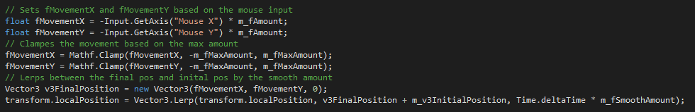
Technical information.
The project was programmed using C#.
It has two different scripts being the player and weapon sway scripts.
The player script has all the movement and controls.

Slide 5
Player script.
Function | Description
Ground Move | Moves the player based on the movement input and stores the velocity to give the feeling of gaining momentum.
Air Move | Allows the player to control the character in the air, such as strafing which allows the player to gain momentum by moving left and right in a specific way.
Change Stance | Changes the stance of the player from crouch to prone, standing, sprinting and sliding.
Slide Down Slope | Checks if the player is on a slope above the slope limit or if the player is on an object tagged "Slide“.
Accelerate | Accelerates the players velocity based on the values passed in such as direction, speed, and accel.

Slide 6
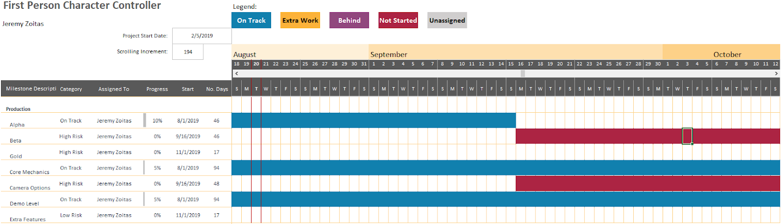
Project changes.
From the initial plan at the start of the year to have a lot of little features the focus was directed towards the movement.
The plan for the project did not take into account other assignments meaning that there was time for the MVP and only a couple extra features.

Slide 7
Bugs encountered.
Bug | Description | Solution
Continuous movement | When I started applying velocity the player it kept moving. | The was solved creating a apply friction function and applying it to the player.
Crouch collision | Crouching under an object would get the player stuck when let go. | As the crouch happened when held down I have to check if the player was colliding/triggering with any object and create a bool determining if they can stand.
Slide angle bug | Sliding would not happen on a certain angle when it should have. | Used OnControllerColliderHit function to set the contact point as it was not being updated

Slide 8
Future work.
There are some improvements that could be applied to the sliding.
Since the movement has been completed with velocity it allows for more possibility to make the player move how people would like.
Extra features can be easily implemented now that there is a base foundation these include: - Lean. - Damage System and death. - Spawn System. - Damage Visualization. - Interact. - Pickup Item. - Ragdoll.

Slide 9
Demonstration and questions.

